Slide 1

Part 2 Storyboard BRK - information jungle

Slide 2
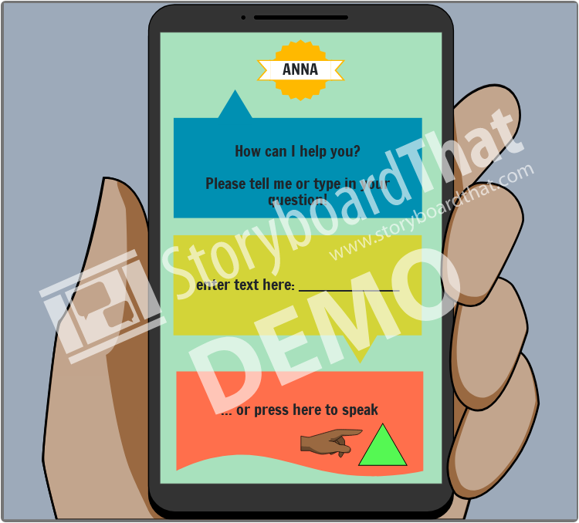

Slide 3
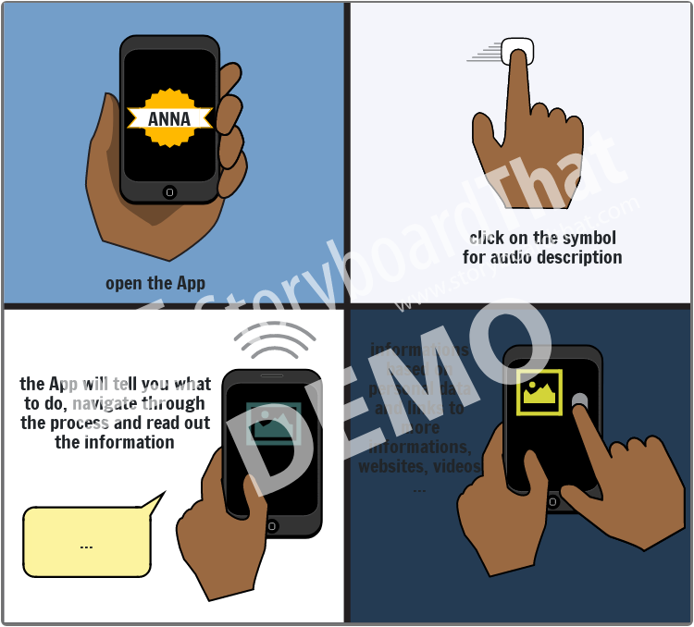

Slide 4
